Slide 1
Challenge-Patent Analysis
Rizwan Ishaq

Slide 2
Introduction
The purpose of this challenge is to address the issue of effectively extracting information from a given patent. Specifically, the challenge focuses on the extraction of product, component, or compound values and their corresponding units. Extracting this information accurately is crucial for understanding the patent's technical details and leveraging its insights for various applications. By developing innovative techniques and tools to automate the extraction process, this challenge aims to enhance efficiency and accessibility in patent analysis, thereby facilitating advancements in relevant industries and fostering intellectual property exploration
Notes:
The purpose of this challenge is to address the issue of effectively extracting information from a given patent. Specifically, the challenge focuses on the extraction of product, component, or compound values and their corresponding units. Extracting this information accurately is crucial for understanding the patent's technical details and leveraging its insights for various applications. By developing innovative techniques and tools to automate the extraction process, this challenge aims to enhance efficiency and accessibility in patent analysis, thereby facilitating advancements in relevant industries and fostering intellectual property exploration

Slide 3
Data
Bulk Data Storage System (BDSS)
https://bulkdata.uspto.gov/
This data set is used only for testing/validation purpose
https://patents.google.com/patent/US8022010B2/en
https: //patents.google.com/patent/EP2778146A1/en
Above two link used for designing the system

Slide 4
System Design
Based on the task of Extraction the measurement
Used the few-shot inference with the OpenAI gpt-3.5 turbo model is used
Few-shot inference
We give some example to the model, based on that from the document model generated the desired output
System given the desire results, and the sentence as well from which that measurement is extracted
The extracted sentences are used to validate that, system is actually giving the results or not

Slide 5
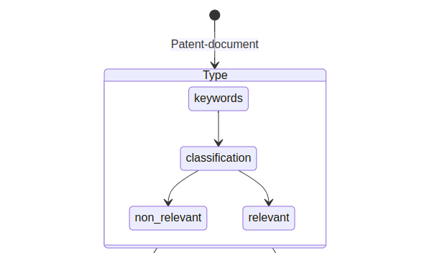
System Diagram

Slide 6
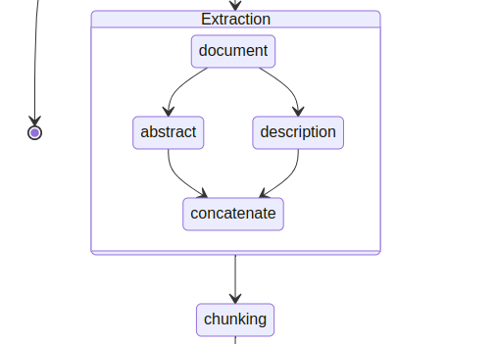
System Design

Slide 7
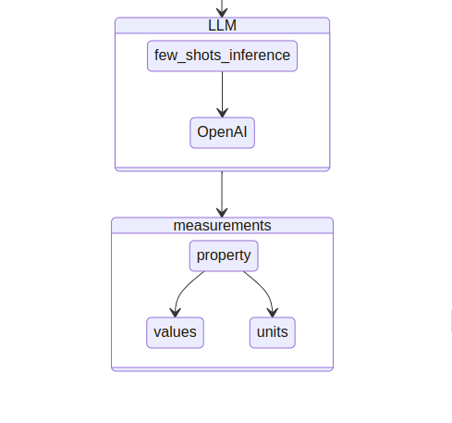
System Design

Slide 8
System Response (Validation) Ex.1
Product: TiN film
Property: average film thickness
Value: 3
unit: µm
sentence: The material in which a TiN film having an average film thickness of 3 µm had been formed on the surface of Present product 1 was made Present product 17, and the material in which a TiAlN film having an average film thickness of 3 µm had been formed on the surface of Present product 1 was made Present product 18.

Slide 9
Evaluation
For the evaluation, I did the manual check from the different patent, i.e. like
https://patents.google.com/patent/US8022010B2/en
https: //patents.google.com/patent/EP2778146A1/en
Based on these two paper, I checked the output sentence, for verification, if the system is extracting the information or not.

Slide 10
Success/Failure Cases
Product: ALKAINE EARTH MATERIAL Property: crystallite size Value: between 10 and 20 unit: nm sentence: In one embodiment, the nitrogen oxide storage material comprises alkaline earth material supported on ceria particles having a crystallite size of between about 10 and 20 nm and the alkaline earth oxide having a crystallite size of between about 20-40 nm.
Product: BaCO3 Property: thermal stress reduction Value: reduced unit: sentence: According to one or more embodiments of the invention, Ba sintering and Ba composite compound formation is reduced under the conditions of thermal stress in an exhaust gas of a lean burn engine.

